Slide 1

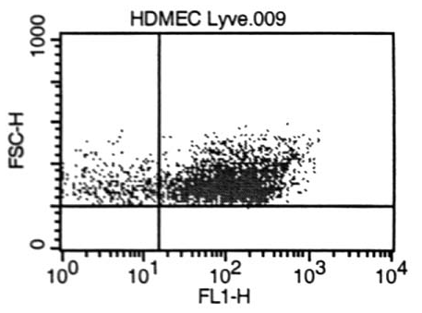
ReliaTech GmbH
Rabbit anti-human LYVE-1
(Cat #102-PA50AG)
Figure 1. FACS analysis with primary human dermal microvascular endothelial cells (HDMVEC).
http://www.reliatech.de / orders@reliatech.de

